Slide 1


Welcome to RAP as a Service Customer Name Ross:767468786
Julien Clauzel
PFE

Slide 2
Agenda
Welcome Email
RaaS Process
Set Milestone Timeline
How to Engage Support

Slide 3
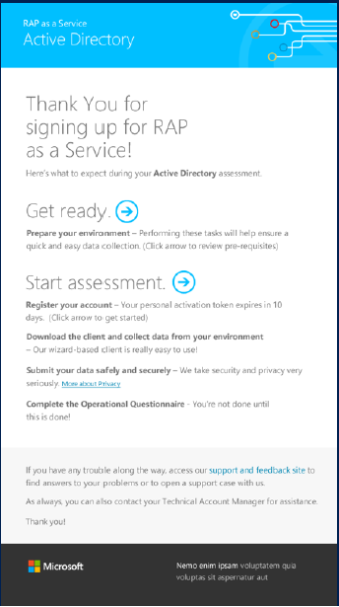
Welcome Email
Welcome email with one-time activation link has been sent.
Blue arrows are the links.
TAM is able to setup additional users on portal by email address.
Email includes link to RaaS Prerequisite. (http://www.microsoft.com/en-us/download/details.aspx?id=34698)
Recommend running the Dynamics CRM RaaS Scoping tool(will be shared by PFE)
The RaaS subscription will start as soon as the tool is downloaded.
RaaS and EaaS Portal - http://services.premier.Microsoft.com
www.microsoft.com/microsoftservices

Slide 4
RaaS Prerequisites
Refer to RaaS Perquisites Doc for full list of prerequisites
(http://www.microsoft.com/en-us/download/details.aspx?id=34698)
<Download and Open the appropriate Prerequisites PDF>
- Meeting the prerequisites is critical to successful data collection
- Make sure to utilize the “Dynamics CRM scoping tool” and strive to have all issues resolved before data collection
www.microsoft.com/microsoftservices
Notes:
Send follow-up email documenting the agreed upon dates.

Slide 5
Overview of RaaS Process
Customer Access Granted to RaaS Portal
Implement prerequisites
-
Run prerequisites script
-
Download Toolset
-
Notify TAM & PFE outcome.
Tool Ran and Results Uploaded
Notify TAM & PFE outcome.
Questionnaire Completed & Submitted
Analyze Findings by TAM & PFE
Key Findings Review & RPS
Welcome Call
www.microsoft.com/microsoftservices

Slide 6
Setting Milestones
Set Dates for following RaaS Milestones
ASAP : Download toolset, implement prerequisites & run prerequisites script.
Maximum __________: Collected data uploaded
Maximum ___________:Questionnaire Complete & Submitted
__________ :Analyze Findings by TAM & PFE
__:__, ________ :Key Findings Review & RPS Meeting
www.microsoft.com/microsoftservices
Notes:
Send follow-up email documenting the agreed upon dates.

Slide 7
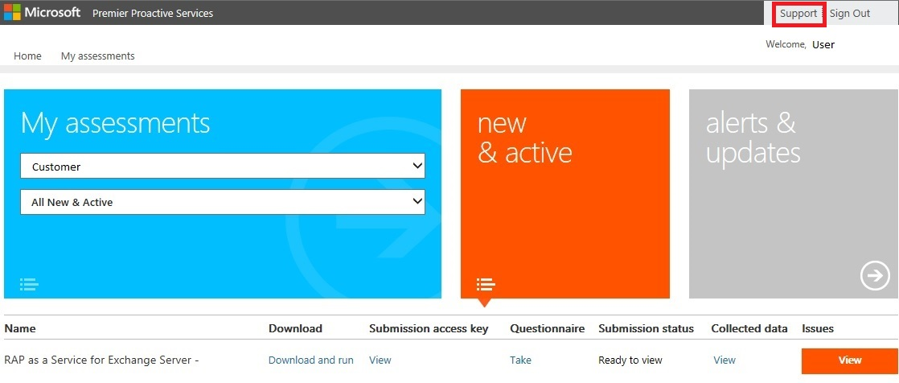
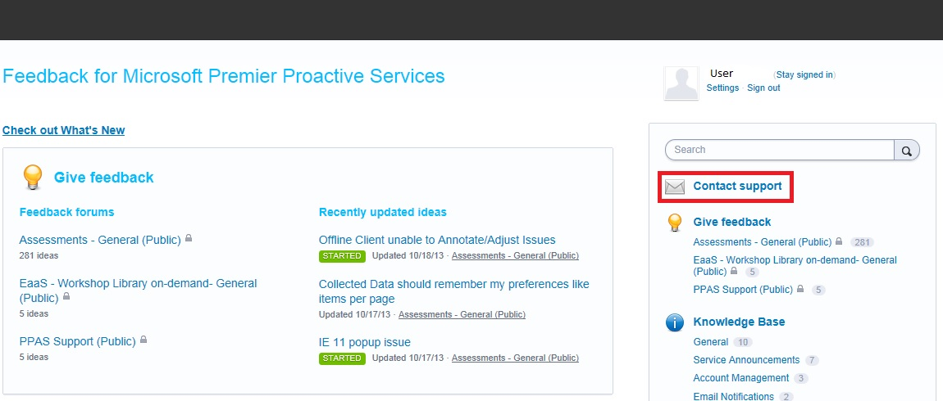
How to Engage Support
Step 1
Step 2
Open case with http://PPAS.uservoice.com
Review knowledge base for documented resolution
Support Link is on RaaS Portal
Axis number can be found on Welcome email and Title slide of this deck
Escalate to TAM if necessary (include on email thread)
www.microsoft.com/microsoftservices
Notes:
The following table summarizes RaaS support for customers and TAMs.
How do Customers get support?
• KB accessible to customer
• E-Ticketing system called UserVoice (http://PPAS.uservoice.com)
• Support provided by Microsoft to the customer
What Customer issues are supported?
• Creating a user account and signing in
• Downloading and running the data collection tool
• Submitting customer data
• Navigating and utilizing the website
• Understanding the assessment results
What to include in ticket submission
• URL of the page you are using
• Customer account name (visible at the top of most web pages) or Axis Request ID
• Error message received
• Operating system and browser version
• SironaTrace.log (user\appdata\local\Microsoft\raas)
• DiscoveryTrace_*.log (user\appdata\local\Microsoft\raas)
Customer expectations for support
• 1st level support => Use the KB
• 2nd level support => Submit UserVoice ticket
• Customer receives ticket number
• Support responses via email
• Respond and engage within 72 hours
• Ongoing communication

Slide 8
Prerequisites script (1/4)
All prerequisites need to be implemented first.
VBScript needs to be ran in the same user context as the RaaS client (from an elevated CMD).
Run the script from tools machine against all CRM & SQL Servers part of the environment.
Generates two log files for troubleshooting:
CRMRaasPreReqsScriptLog.txt
CRMRaasPreReqsFailuresLog.txt

Slide 9
Prerequisites script (2/4)
Example:
cscript VerifyCRMRaaSPreReq-V3.0.vbs crmappserver crmsqlserver
Output is divided in 4 sections:
1 - Performing tool machine local tests.
2 - Analyzing tool machine configuration.
3 - Performing remote tests (inc sysadmin).
4 – Overall summary results.

Slide 10
Prerequisites script (3/4)
Minimum goals:
« Required Dynamics CRM RaaS prerequisites PASSED
&
Completed successfully user sysadmin role check
Sample summary output with failures at end of script | Sample summary output with failures PASSED at end of script
Required Dynamics CRM RaaS prerequisites FAILED with 1 error(s) and 6 warning(s). Tools machine performance warnings: 1. IIS logs warnings: 5. | Required Dynamics CRM RaaS prerequisites PASSED with 0 warning(s). Completed successfully user sysadmin role check on <crm2011>

Slide 11
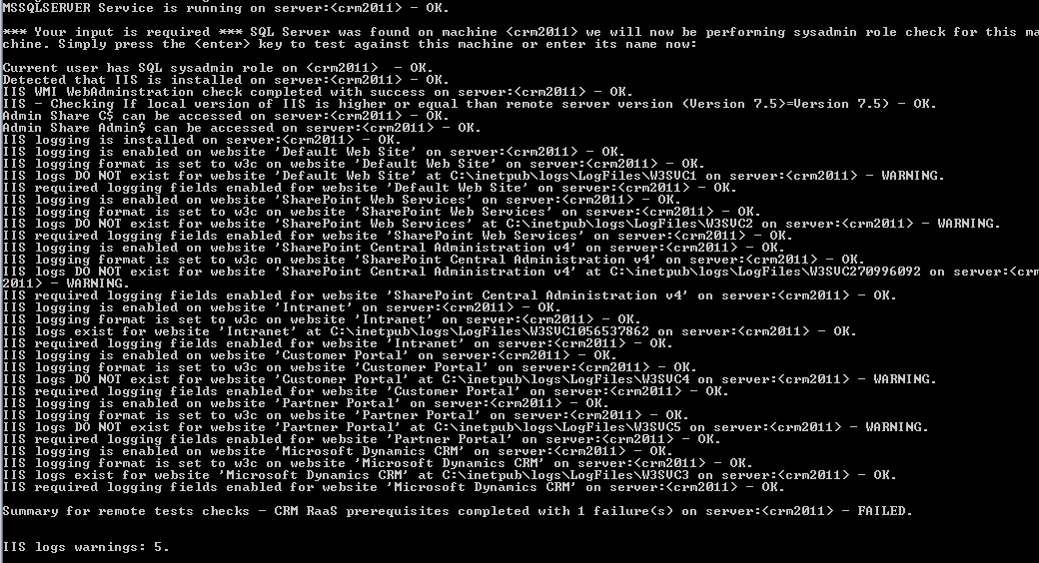
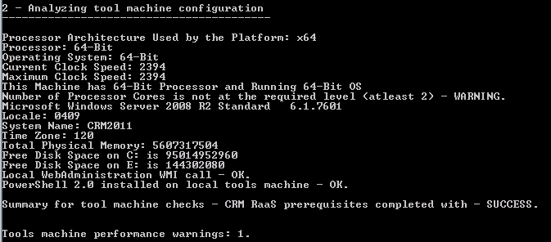
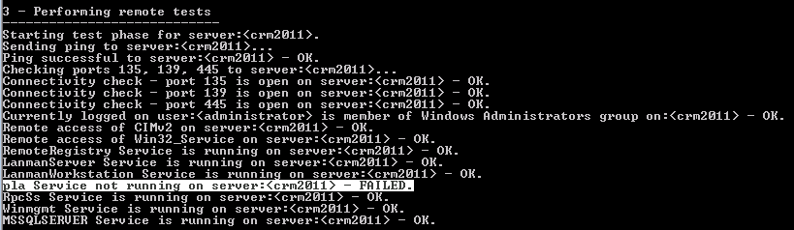
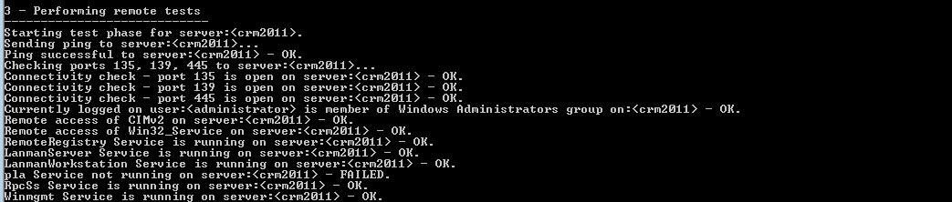
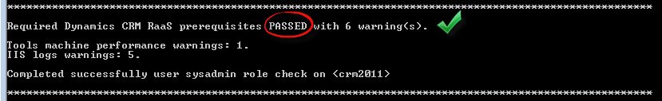
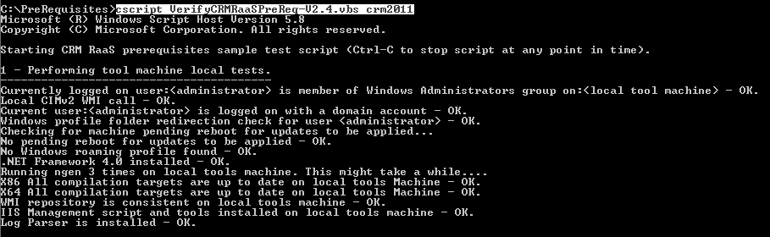
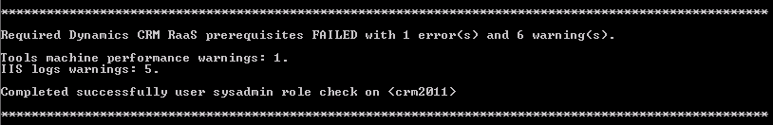

Prerequisites script (4/4)

Slide 12
RaaS Client
Plan two data collection:
Plan 4 hours per data collection.
Collect at peak load.
Rename « Document\RaaS » to force new « discovery » for second data collection.

Slide 13
Common Issues
Issue | Remediation
Submission Failures | Make sure all prerequisites are in place (by reading & implementing the prerequisites document as soon as possible). Use the prerequisites script in order to verify that all necessary CRM RaaS prerequisites are “PASSED” and met. Notify TAM & PFE of any challenge as quickly & early as possible.
Account Management | Ensure you log on with a Microsoft account within 10 days of receiving your activation email. The activation token will expire and your TAM will need to reset it for you for another 10 days.
Sign In Failures | Signing in with an In-Private Browser session to ensure other credentials (other than the credentials associated with the activation token) are not being used to log on. Use one of the supported browsers. Our officially supported browsers include Internet Explorer 9, 10, and 11. Most other modern HTML5 based browsers will also work, however, since IE8 does not support HTML5, it is no longer supported.
www.microsoft.com/microsoftservices
Notes:
The following table summarizes RaaS support for customers and TAMs.
How do Customers get support?
• KB accessible to customer
• E-Ticketing system called UserVoice (http://PPAS.uservoice.com)
• Support provided by Microsoft to the customer
What Customer issues are supported?
• Creating a user account and signing in
• Downloading and running the data collection tool
• Submitting customer data
• Navigating and utilizing the website
• Understanding the assessment results
What to include in ticket submission
• URL of the page you are using
• Customer account name (visible at the top of most web pages) or Axis Request ID
• Error message received
• Operating system and browser version
• SironaTrace.log (user\appdata\local\Microsoft\raas)
• DiscoveryTrace_*.log (user\appdata\local\Microsoft\raas)
Customer expectations for support
• 1st level support => Use the KB
• 2nd level support => Submit UserVoice ticket
• Customer receives ticket number
• Support responses via email
• Respond and engage within 72 hours
• Ongoing communication

Slide 14
Questions
Customer Access Granted to RaaS Portal
Implement prerequisites
-
Run prerequisites script
-
Download Toolset
-
Notify TAM & PFE outcome..
Tool Ran and Results Uploaded
Notify TAM & PFE outcome.
Questionnaire Completed & Submitted
Analyze Findings by TAM & PFE
Key Findings Review & RPS
Welcome Call
www.microsoft.com/microsoftservices
Notes:
The following table summarizes RaaS support for customers and TAMs.
How do Customers get support?
• KB accessible to customer
• E-Ticketing system called UserVoice (http://PPAS.uservoice.com)
• Support provided by Microsoft to the customer
What Customer issues are supported?
• Creating a user account and signing in
• Downloading and running the data collection tool
• Submitting customer data
• Navigating and utilizing the website
• Understanding the assessment results
What to include in ticket submission
• URL of the page you are using
• Customer account name (visible at the top of most web pages) or Axis Request ID
• Error message received
• Operating system and browser version
• SironaTrace.log (user\appdata\local\Microsoft\raas)
• DiscoveryTrace_*.log (user\appdata\local\Microsoft\raas)
Customer expectations for support
• 1st level support => Use the KB
• 2nd level support => Submit UserVoice ticket
• Customer receives ticket number
• Support responses via email
• Respond and engage within 72 hours
• Ongoing communication

